Slide 1
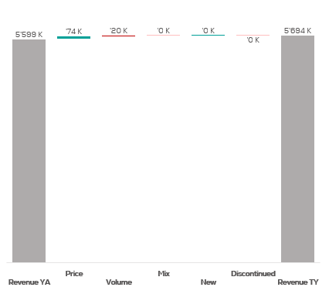
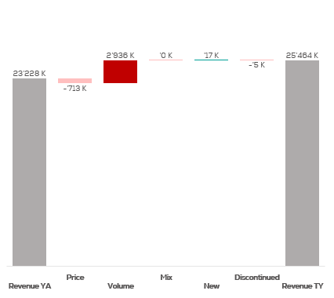
Revenue by Price vs. Volume vs. Mix analysis (Replace with So What)
Revenue by Price vs. Volume vs. Mix analysis | Nicolas vs. Ruinart | Effervescents | NATIONAL | P12M
Nicolas
Ruinart
DATA SOURCE: Trade Panel/Retailer Data | Ending June 2025

Slide 2
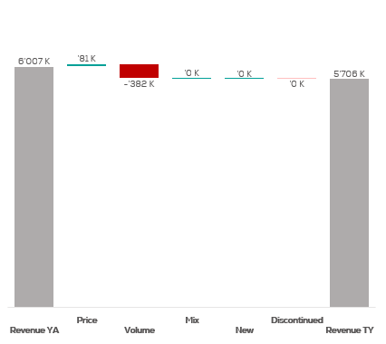
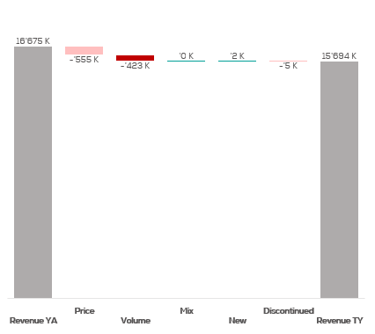
Revenue by Price vs. Volume vs. Mix analysis (Replace with So What)
Revenue by Price vs. Volume vs. Mix analysis | Nicolas vs. Ruinart | Effervescents | NICOLAS | P12M
Nicolas
Ruinart
DATA SOURCE: Trade Panel/Retailer Data | Ending June 2025

Slide 3
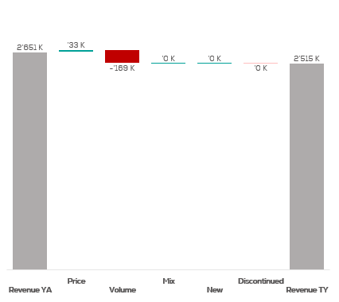
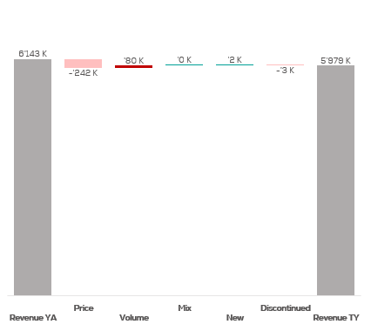
Revenue by Price vs. Volume vs. Mix analysis (Replace with So What)
Revenue by Price vs. Volume vs. Mix analysis | Nicolas vs. Ruinart | Effervescents | NICOLAS QCN | P12M
Nicolas
Ruinart
DATA SOURCE: Trade Panel/Retailer Data | Ending June 2025

Slide 4
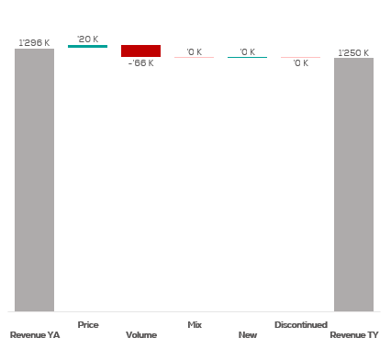
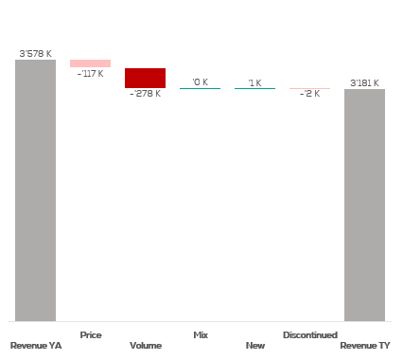
Revenue by Price vs. Volume vs. Mix analysis (Replace with So What)
Revenue by Price vs. Volume vs. Mix analysis | Nicolas vs. Ruinart | Effervescents | NICOLAS VCN | P12M
Nicolas
Ruinart
DATA SOURCE: Trade Panel/Retailer Data | Ending June 2025

Slide 5
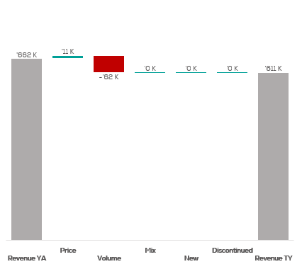
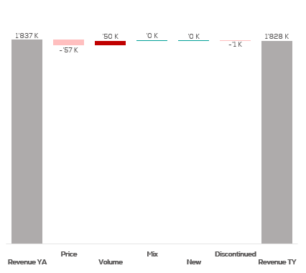
Revenue by Price vs. Volume vs. Mix analysis (Replace with So What)
Revenue by Price vs. Volume vs. Mix analysis | Nicolas vs. Ruinart | Effervescents | NICOLAS QCT | P12M
Nicolas
Ruinart
DATA SOURCE: Trade Panel/Retailer Data | Ending June 2025

Slide 6
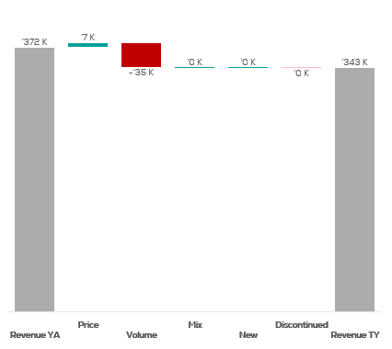
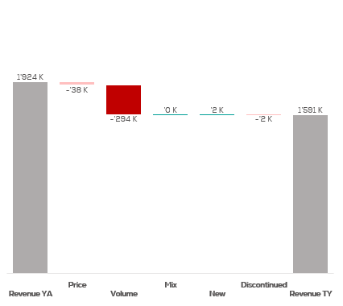
Revenue by Price vs. Volume vs. Mix analysis (Replace with So What)
Revenue by Price vs. Volume vs. Mix analysis | Nicolas vs. Ruinart | Effervescents | NICOLAS QCA | P12M
Nicolas
Ruinart
DATA SOURCE: Trade Panel/Retailer Data | Ending June 2025

Slide 7
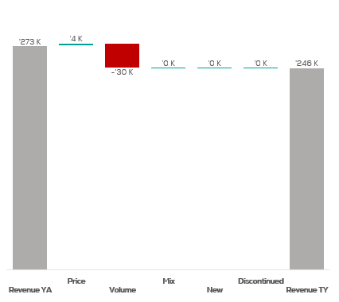
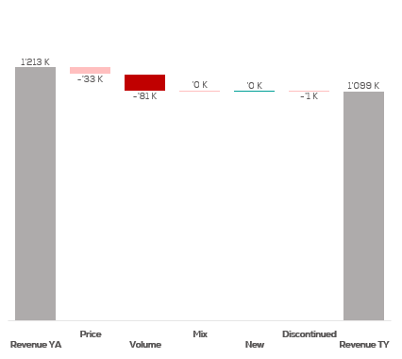
Revenue by Price vs. Volume vs. Mix analysis (Replace with So What)
Revenue by Price vs. Volume vs. Mix analysis | Nicolas vs. Ruinart | Effervescents | NICOLAS CCP | P12M
Nicolas
Ruinart
DATA SOURCE: Trade Panel/Retailer Data | Ending June 2025

Slide 8
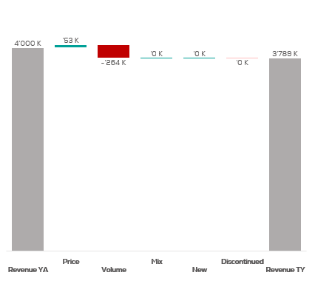
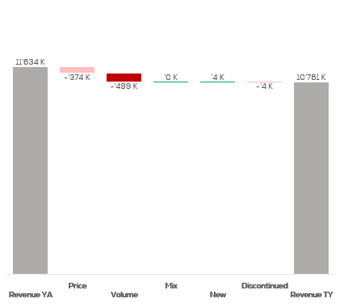
Revenue by Price vs. Volume vs. Mix analysis (Replace with So What)
Revenue by Price vs. Volume vs. Mix analysis | Nicolas vs. Ruinart | Effervescents | NICOLAS IDF | P12M
Nicolas
Ruinart
DATA SOURCE: Trade Panel/Retailer Data | Ending June 2025

Slide 9
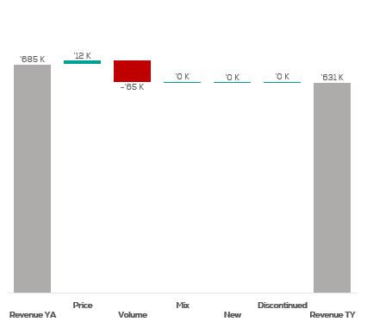
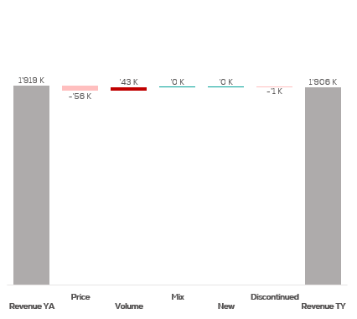
Revenue by Price vs. Volume vs. Mix analysis (Replace with So What)
Revenue by Price vs. Volume vs. Mix analysis | Nicolas vs. Ruinart | Effervescents | NICOLAS PAC | P12M
Nicolas
Ruinart
DATA SOURCE: Trade Panel/Retailer Data | Ending June 2025

Slide 10
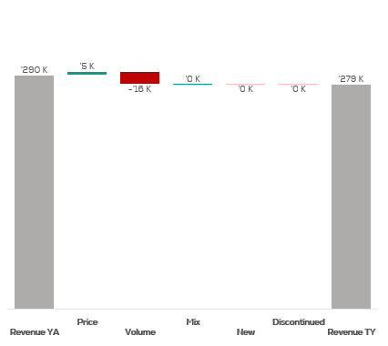
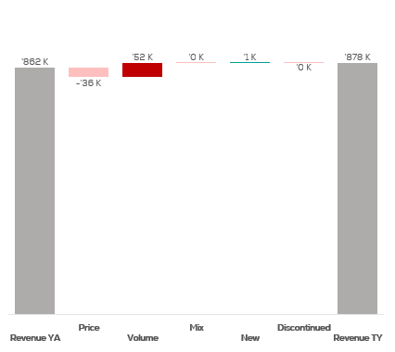
Revenue by Price vs. Volume vs. Mix analysis (Replace with So What)
Revenue by Price vs. Volume vs. Mix analysis | Nicolas vs. Ruinart | Effervescents | NICOLAS RHO | P12M
Nicolas
Ruinart
DATA SOURCE: Trade Panel/Retailer Data | Ending June 2025

Slide 11
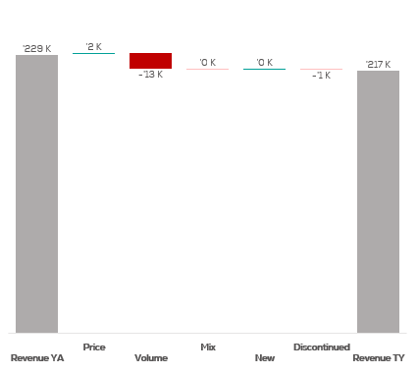
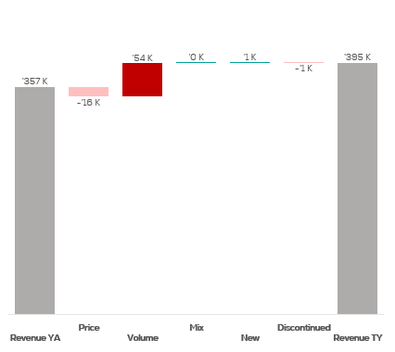
Revenue by Price vs. Volume vs. Mix analysis (Replace with So What)
Revenue by Price vs. Volume vs. Mix analysis | Nicolas vs. Ruinart | Effervescents | NICOLAS AQU | P12M
Nicolas
Ruinart
DATA SOURCE: Trade Panel/Retailer Data | Ending June 2025

Slide 12
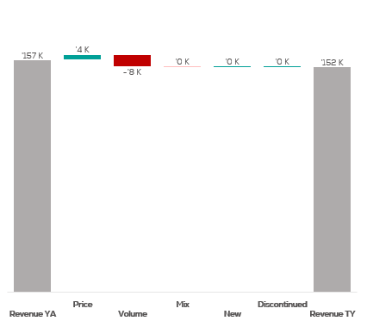
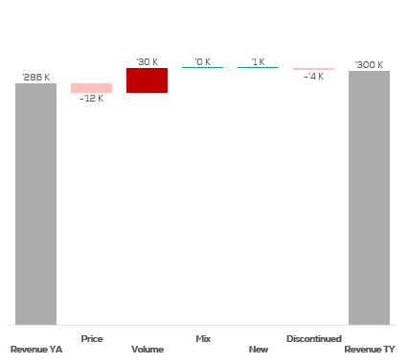
Revenue by Price vs. Volume vs. Mix analysis (Replace with So What)
Revenue by Price vs. Volume vs. Mix analysis | Nicolas vs. Ruinart | Effervescents | NICOLAS EST | P12M
Nicolas
Ruinart
DATA SOURCE: Trade Panel/Retailer Data | Ending June 2025

Slide 13
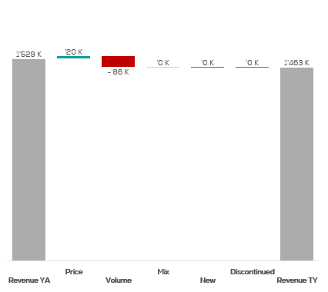
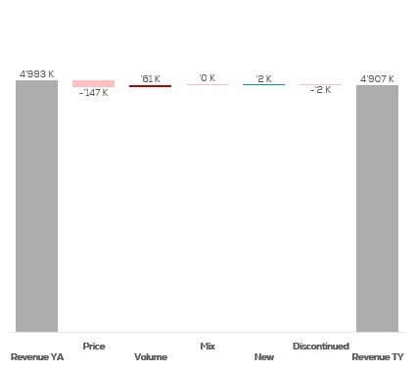
Revenue by Price vs. Volume vs. Mix analysis (Replace with So What)
Revenue by Price vs. Volume vs. Mix analysis | Nicolas vs. Ruinart | Effervescents | CA A | P12M
Nicolas
Ruinart
DATA SOURCE: Trade Panel/Retailer Data | Ending June 2025

Slide 14
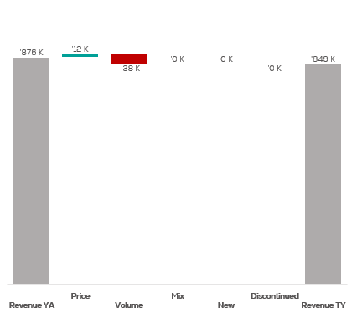
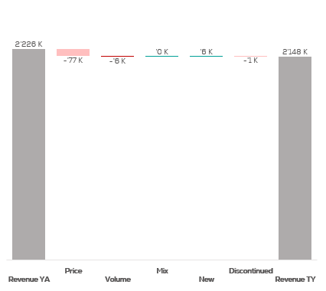
Revenue by Price vs. Volume vs. Mix analysis (Replace with So What)
Revenue by Price vs. Volume vs. Mix analysis | Nicolas vs. Ruinart | Effervescents | CA B | P12M
Nicolas
Ruinart
DATA SOURCE: Trade Panel/Retailer Data | Ending June 2025

Slide 15
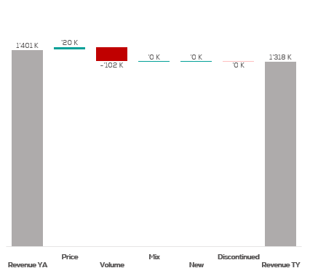
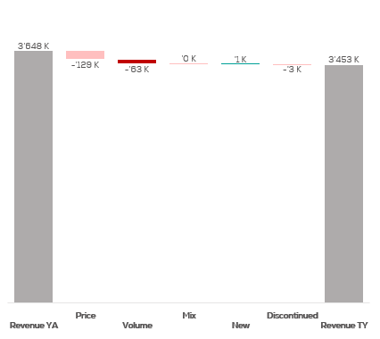
Revenue by Price vs. Volume vs. Mix analysis (Replace with So What)
Revenue by Price vs. Volume vs. Mix analysis | Nicolas vs. Ruinart | Effervescents | CA C | P12M
Nicolas
Ruinart
DATA SOURCE: Trade Panel/Retailer Data | Ending June 2025

Slide 16
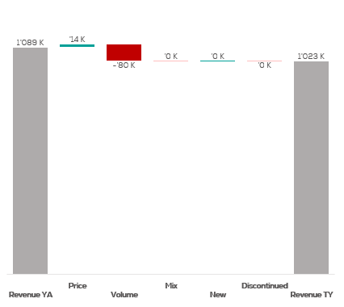
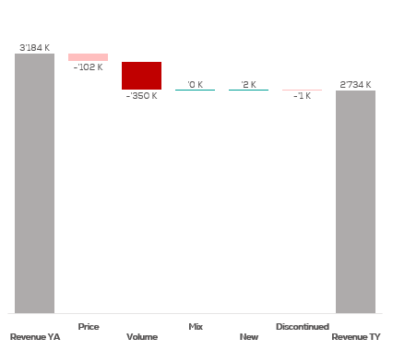
Revenue by Price vs. Volume vs. Mix analysis (Replace with So What)
Revenue by Price vs. Volume vs. Mix analysis | Nicolas vs. Ruinart | Effervescents | CA D | P12M
Nicolas
Ruinart
DATA SOURCE: Trade Panel/Retailer Data | Ending June 2025

Slide 17
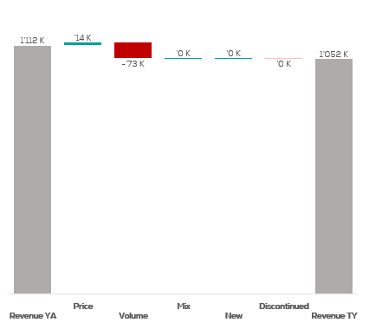
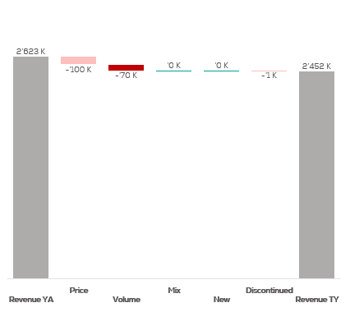
Revenue by Price vs. Volume vs. Mix analysis (Replace with So What)
Revenue by Price vs. Volume vs. Mix analysis | Nicolas vs. Ruinart | Effervescents | CA E | P12M
Nicolas
Ruinart
DATA SOURCE: Trade Panel/Retailer Data | Ending June 2025

Slide 18
Revenue by Price vs. Volume vs. Mix analysis (Replace with So What)
Revenue by Price vs. Volume vs. Mix analysis | Nicolas vs. Ruinart | Champagnes | NATIONAL | P12M
Nicolas
Ruinart
DATA SOURCE: Trade Panel/Retailer Data | Ending June 2025

Slide 19
Revenue by Price vs. Volume vs. Mix analysis (Replace with So What)
Revenue by Price vs. Volume vs. Mix analysis | Nicolas vs. Ruinart | Champagnes | NICOLAS | P12M
Nicolas
Ruinart
DATA SOURCE: Trade Panel/Retailer Data | Ending June 2025

Slide 20
Revenue by Price vs. Volume vs. Mix analysis (Replace with So What)
Revenue by Price vs. Volume vs. Mix analysis | Nicolas vs. Ruinart | Champagnes | NICOLAS QCN | P12M
Nicolas
Ruinart
DATA SOURCE: Trade Panel/Retailer Data | Ending June 2025

Slide 21
Revenue by Price vs. Volume vs. Mix analysis (Replace with So What)
Revenue by Price vs. Volume vs. Mix analysis | Nicolas vs. Ruinart | Champagnes | NICOLAS VCN | P12M
Nicolas
Ruinart
DATA SOURCE: Trade Panel/Retailer Data | Ending June 2025

Slide 22
Revenue by Price vs. Volume vs. Mix analysis (Replace with So What)
Revenue by Price vs. Volume vs. Mix analysis | Nicolas vs. Ruinart | Champagnes | NICOLAS QCT | P12M
Nicolas
Ruinart
DATA SOURCE: Trade Panel/Retailer Data | Ending June 2025

Slide 23
Revenue by Price vs. Volume vs. Mix analysis (Replace with So What)
Revenue by Price vs. Volume vs. Mix analysis | Nicolas vs. Ruinart | Champagnes | NICOLAS QCA | P12M
Nicolas
Ruinart
DATA SOURCE: Trade Panel/Retailer Data | Ending June 2025

Slide 24
Revenue by Price vs. Volume vs. Mix analysis (Replace with So What)
Revenue by Price vs. Volume vs. Mix analysis | Nicolas vs. Ruinart | Champagnes | NICOLAS CCP | P12M
Nicolas
Ruinart
DATA SOURCE: Trade Panel/Retailer Data | Ending June 2025

Slide 25
Revenue by Price vs. Volume vs. Mix analysis (Replace with So What)
Revenue by Price vs. Volume vs. Mix analysis | Nicolas vs. Ruinart | Champagnes | NICOLAS IDF | P12M
Nicolas
Ruinart
DATA SOURCE: Trade Panel/Retailer Data | Ending June 2025

Slide 26
Revenue by Price vs. Volume vs. Mix analysis (Replace with So What)
Revenue by Price vs. Volume vs. Mix analysis | Nicolas vs. Ruinart | Champagnes | NICOLAS PAC | P12M
Nicolas
Ruinart
DATA SOURCE: Trade Panel/Retailer Data | Ending June 2025

Slide 27
Revenue by Price vs. Volume vs. Mix analysis (Replace with So What)
Revenue by Price vs. Volume vs. Mix analysis | Nicolas vs. Ruinart | Champagnes | NICOLAS RHO | P12M
Nicolas
Ruinart
DATA SOURCE: Trade Panel/Retailer Data | Ending June 2025

Slide 28
Revenue by Price vs. Volume vs. Mix analysis (Replace with So What)
Revenue by Price vs. Volume vs. Mix analysis | Nicolas vs. Ruinart | Champagnes | NICOLAS AQU | P12M
Nicolas
Ruinart
DATA SOURCE: Trade Panel/Retailer Data | Ending June 2025

Slide 29
Revenue by Price vs. Volume vs. Mix analysis (Replace with So What)
Revenue by Price vs. Volume vs. Mix analysis | Nicolas vs. Ruinart | Champagnes | NICOLAS EST | P12M
Nicolas
Ruinart
DATA SOURCE: Trade Panel/Retailer Data | Ending June 2025

Slide 30
Revenue by Price vs. Volume vs. Mix analysis (Replace with So What)
Revenue by Price vs. Volume vs. Mix analysis | Nicolas vs. Ruinart | Champagnes | CA A | P12M
Nicolas
Ruinart
DATA SOURCE: Trade Panel/Retailer Data | Ending June 2025

Slide 31
Revenue by Price vs. Volume vs. Mix analysis (Replace with So What)
Revenue by Price vs. Volume vs. Mix analysis | Nicolas vs. Ruinart | Champagnes | CA B | P12M
Nicolas
Ruinart
DATA SOURCE: Trade Panel/Retailer Data | Ending June 2025

Slide 32
Revenue by Price vs. Volume vs. Mix analysis (Replace with So What)
Revenue by Price vs. Volume vs. Mix analysis | Nicolas vs. Ruinart | Champagnes | CA C | P12M
Nicolas
Ruinart
DATA SOURCE: Trade Panel/Retailer Data | Ending June 2025

Slide 33
Revenue by Price vs. Volume vs. Mix analysis (Replace with So What)
Revenue by Price vs. Volume vs. Mix analysis | Nicolas vs. Ruinart | Champagnes | CA D | P12M
Nicolas
Ruinart
DATA SOURCE: Trade Panel/Retailer Data | Ending June 2025

Slide 34
Revenue by Price vs. Volume vs. Mix analysis (Replace with So What)
Revenue by Price vs. Volume vs. Mix analysis | Nicolas vs. Ruinart | Champagnes | CA E | P12M
Nicolas
Ruinart
DATA SOURCE: Trade Panel/Retailer Data | Ending June 2025

Slide 35
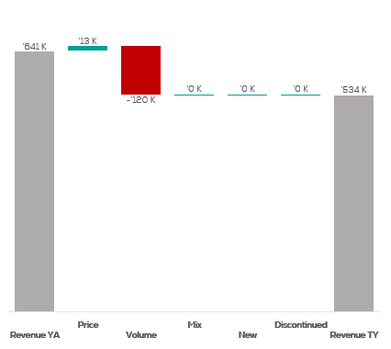
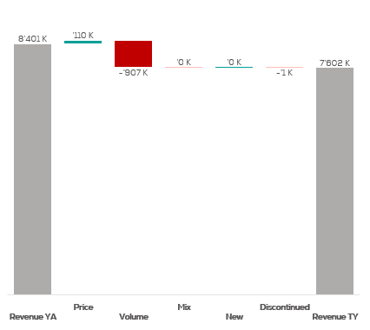
Revenue by Price vs. Volume vs. Mix analysis (Replace with So What)
Revenue by Price vs. Volume vs. Mix analysis | Nicolas vs. Ruinart | Blanc De Blancs | NATIONAL | P12M
Nicolas
Ruinart
DATA SOURCE: Trade Panel/Retailer Data | Ending June 2025

Slide 36
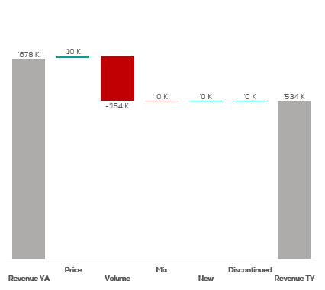
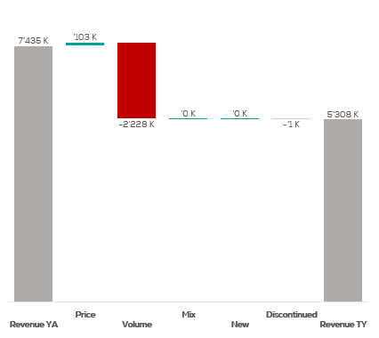
Revenue by Price vs. Volume vs. Mix analysis (Replace with So What)
Revenue by Price vs. Volume vs. Mix analysis | Nicolas vs. Ruinart | Blanc De Blancs | NICOLAS | P12M
Nicolas
Ruinart
DATA SOURCE: Trade Panel/Retailer Data | Ending June 2025

Slide 37
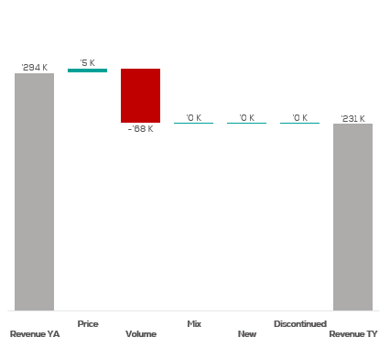

Revenue by Price vs. Volume vs. Mix analysis (Replace with So What)
Revenue by Price vs. Volume vs. Mix analysis | Nicolas vs. Ruinart | Blanc De Blancs | NICOLAS QCN | P12M
Nicolas
Ruinart
DATA SOURCE: Trade Panel/Retailer Data | Ending June 2025

Slide 38
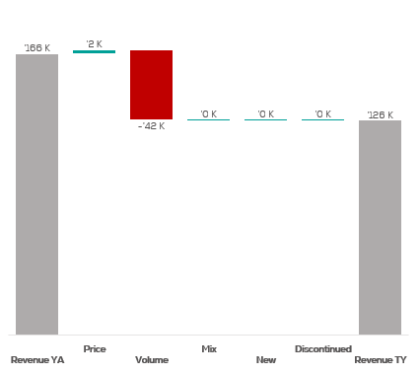
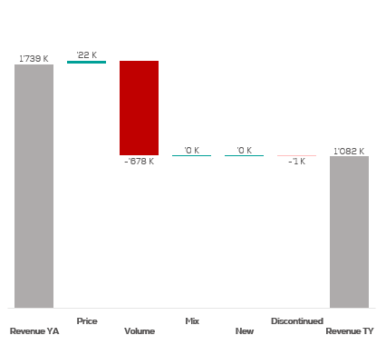
Revenue by Price vs. Volume vs. Mix analysis (Replace with So What)
Revenue by Price vs. Volume vs. Mix analysis | Nicolas vs. Ruinart | Blanc De Blancs | NICOLAS VCN | P12M
Nicolas
Ruinart
DATA SOURCE: Trade Panel/Retailer Data | Ending June 2025

Slide 39

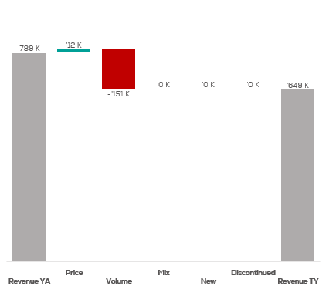
Revenue by Price vs. Volume vs. Mix analysis (Replace with So What)
Revenue by Price vs. Volume vs. Mix analysis | Nicolas vs. Ruinart | Blanc De Blancs | NICOLAS QCT | P12M
Nicolas
Ruinart
DATA SOURCE: Trade Panel/Retailer Data | Ending June 2025

Slide 40

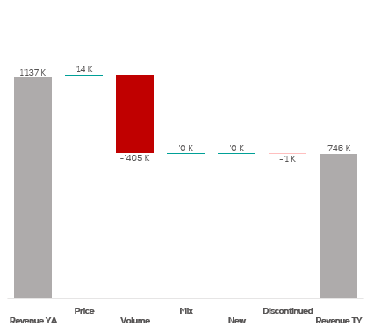
Revenue by Price vs. Volume vs. Mix analysis (Replace with So What)
Revenue by Price vs. Volume vs. Mix analysis | Nicolas vs. Ruinart | Blanc De Blancs | NICOLAS QCA | P12M
Nicolas
Ruinart
DATA SOURCE: Trade Panel/Retailer Data | Ending June 2025

Slide 41
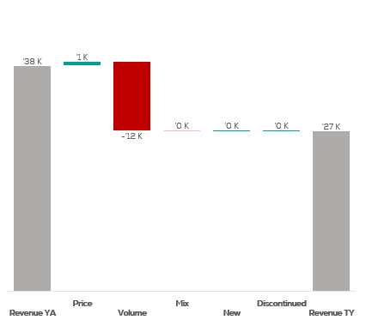
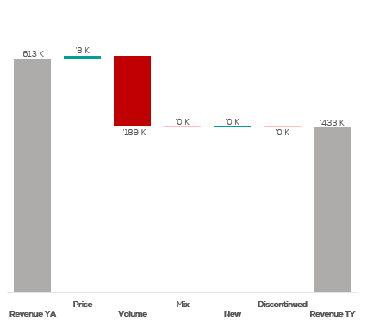
Revenue by Price vs. Volume vs. Mix analysis (Replace with So What)
Revenue by Price vs. Volume vs. Mix analysis | Nicolas vs. Ruinart | Blanc De Blancs | NICOLAS CCP | P12M
Nicolas
Ruinart
DATA SOURCE: Trade Panel/Retailer Data | Ending June 2025

Slide 42
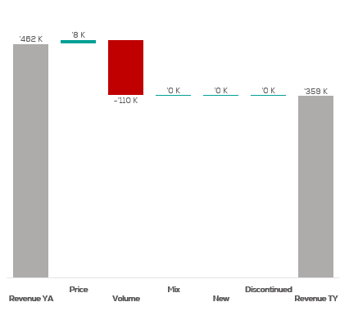
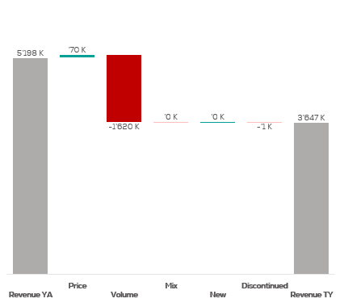
Revenue by Price vs. Volume vs. Mix analysis (Replace with So What)
Revenue by Price vs. Volume vs. Mix analysis | Nicolas vs. Ruinart | Blanc De Blancs | NICOLAS IDF | P12M
Nicolas
Ruinart
DATA SOURCE: Trade Panel/Retailer Data | Ending June 2025

Slide 43
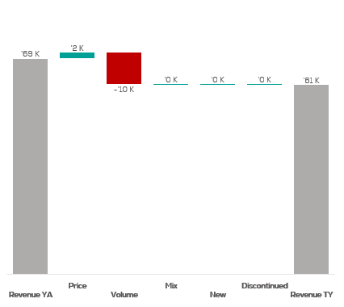

Revenue by Price vs. Volume vs. Mix analysis (Replace with So What)
Revenue by Price vs. Volume vs. Mix analysis | Nicolas vs. Ruinart | Blanc De Blancs | NICOLAS PAC | P12M
Nicolas
Ruinart
DATA SOURCE: Trade Panel/Retailer Data | Ending June 2025

Slide 44
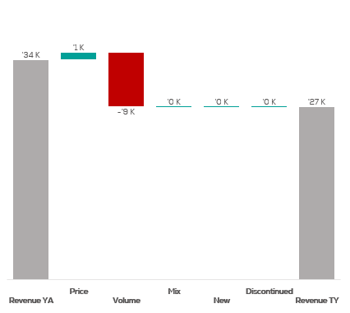

Revenue by Price vs. Volume vs. Mix analysis (Replace with So What)
Revenue by Price vs. Volume vs. Mix analysis | Nicolas vs. Ruinart | Blanc De Blancs | NICOLAS RHO | P12M
Nicolas
Ruinart
DATA SOURCE: Trade Panel/Retailer Data | Ending June 2025

Slide 45
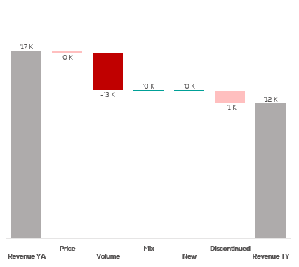

Revenue by Price vs. Volume vs. Mix analysis (Replace with So What)
Revenue by Price vs. Volume vs. Mix analysis | Nicolas vs. Ruinart | Blanc De Blancs | NICOLAS AQU | P12M
Nicolas
Ruinart
DATA SOURCE: Trade Panel/Retailer Data | Ending June 2025

Slide 46


Revenue by Price vs. Volume vs. Mix analysis (Replace with So What)
Revenue by Price vs. Volume vs. Mix analysis | Nicolas vs. Ruinart | Blanc De Blancs | NICOLAS EST | P12M
Nicolas
Ruinart
DATA SOURCE: Trade Panel/Retailer Data | Ending June 2025

Slide 47


Revenue by Price vs. Volume vs. Mix analysis (Replace with So What)
Revenue by Price vs. Volume vs. Mix analysis | Nicolas vs. Ruinart | Blanc De Blancs | CA A | P12M
Nicolas
Ruinart
DATA SOURCE: Trade Panel/Retailer Data | Ending June 2025

Slide 48


Revenue by Price vs. Volume vs. Mix analysis (Replace with So What)
Revenue by Price vs. Volume vs. Mix analysis | Nicolas vs. Ruinart | Blanc De Blancs | CA B | P12M
Nicolas
Ruinart
DATA SOURCE: Trade Panel/Retailer Data | Ending June 2025

Slide 49


Revenue by Price vs. Volume vs. Mix analysis (Replace with So What)
Revenue by Price vs. Volume vs. Mix analysis | Nicolas vs. Ruinart | Blanc De Blancs | CA C | P12M
Nicolas
Ruinart
DATA SOURCE: Trade Panel/Retailer Data | Ending June 2025

Slide 50


Revenue by Price vs. Volume vs. Mix analysis (Replace with So What)
Revenue by Price vs. Volume vs. Mix analysis | Nicolas vs. Ruinart | Blanc De Blancs | CA D | P12M
Nicolas
Ruinart
DATA SOURCE: Trade Panel/Retailer Data | Ending June 2025

Slide 51


Revenue by Price vs. Volume vs. Mix analysis (Replace with So What)
Revenue by Price vs. Volume vs. Mix analysis | Nicolas vs. Ruinart | Blanc De Blancs | CA E | P12M
Nicolas
Ruinart
DATA SOURCE: Trade Panel/Retailer Data | Ending June 2025

Slide 52


Revenue by Price vs. Volume vs. Mix analysis (Replace with So What)
Revenue by Price vs. Volume vs. Mix analysis | Nicolas vs. Ruinart | Bruts | NATIONAL | P12M
Nicolas
Ruinart
DATA SOURCE: Trade Panel/Retailer Data | Ending June 2025

Slide 53


Revenue by Price vs. Volume vs. Mix analysis (Replace with So What)
Revenue by Price vs. Volume vs. Mix analysis | Nicolas vs. Ruinart | Bruts | NICOLAS | P12M
Nicolas
Ruinart
DATA SOURCE: Trade Panel/Retailer Data | Ending June 2025

Slide 54


Revenue by Price vs. Volume vs. Mix analysis (Replace with So What)
Revenue by Price vs. Volume vs. Mix analysis | Nicolas vs. Ruinart | Bruts | NICOLAS QCN | P12M
Nicolas
Ruinart
DATA SOURCE: Trade Panel/Retailer Data | Ending June 2025

Slide 55


Revenue by Price vs. Volume vs. Mix analysis (Replace with So What)
Revenue by Price vs. Volume vs. Mix analysis | Nicolas vs. Ruinart | Bruts | NICOLAS VCN | P12M
Nicolas
Ruinart
DATA SOURCE: Trade Panel/Retailer Data | Ending June 2025

Slide 56


Revenue by Price vs. Volume vs. Mix analysis (Replace with So What)
Revenue by Price vs. Volume vs. Mix analysis | Nicolas vs. Ruinart | Bruts | NICOLAS QCT | P12M
Nicolas
Ruinart
DATA SOURCE: Trade Panel/Retailer Data | Ending June 2025

Slide 57


Revenue by Price vs. Volume vs. Mix analysis (Replace with So What)
Revenue by Price vs. Volume vs. Mix analysis | Nicolas vs. Ruinart | Bruts | NICOLAS QCA | P12M
Nicolas
Ruinart
DATA SOURCE: Trade Panel/Retailer Data | Ending June 2025

Slide 58


Revenue by Price vs. Volume vs. Mix analysis (Replace with So What)
Revenue by Price vs. Volume vs. Mix analysis | Nicolas vs. Ruinart | Bruts | NICOLAS CCP | P12M
Nicolas
Ruinart
DATA SOURCE: Trade Panel/Retailer Data | Ending June 2025

Slide 59


Revenue by Price vs. Volume vs. Mix analysis (Replace with So What)
Revenue by Price vs. Volume vs. Mix analysis | Nicolas vs. Ruinart | Bruts | NICOLAS IDF | P12M
Nicolas
Ruinart
DATA SOURCE: Trade Panel/Retailer Data | Ending June 2025

Slide 60


Revenue by Price vs. Volume vs. Mix analysis (Replace with So What)
Revenue by Price vs. Volume vs. Mix analysis | Nicolas vs. Ruinart | Bruts | NICOLAS PAC | P12M
Nicolas
Ruinart
DATA SOURCE: Trade Panel/Retailer Data | Ending June 2025

Slide 61


Revenue by Price vs. Volume vs. Mix analysis (Replace with So What)
Revenue by Price vs. Volume vs. Mix analysis | Nicolas vs. Ruinart | Bruts | NICOLAS RHO | P12M
Nicolas
Ruinart
DATA SOURCE: Trade Panel/Retailer Data | Ending June 2025

Slide 62


Revenue by Price vs. Volume vs. Mix analysis (Replace with So What)
Revenue by Price vs. Volume vs. Mix analysis | Nicolas vs. Ruinart | Bruts | NICOLAS AQU | P12M
Nicolas
Ruinart
DATA SOURCE: Trade Panel/Retailer Data | Ending June 2025

Slide 63


Revenue by Price vs. Volume vs. Mix analysis (Replace with So What)
Revenue by Price vs. Volume vs. Mix analysis | Nicolas vs. Ruinart | Bruts | NICOLAS EST | P12M
Nicolas
Ruinart
DATA SOURCE: Trade Panel/Retailer Data | Ending June 2025

Slide 64


Revenue by Price vs. Volume vs. Mix analysis (Replace with So What)
Revenue by Price vs. Volume vs. Mix analysis | Nicolas vs. Ruinart | Bruts | CA A | P12M
Nicolas
Ruinart
DATA SOURCE: Trade Panel/Retailer Data | Ending June 2025

Slide 65


Revenue by Price vs. Volume vs. Mix analysis (Replace with So What)
Revenue by Price vs. Volume vs. Mix analysis | Nicolas vs. Ruinart | Bruts | CA B | P12M
Nicolas
Ruinart
DATA SOURCE: Trade Panel/Retailer Data | Ending June 2025

Slide 66


Revenue by Price vs. Volume vs. Mix analysis (Replace with So What)
Revenue by Price vs. Volume vs. Mix analysis | Nicolas vs. Ruinart | Bruts | CA C | P12M
Nicolas
Ruinart
DATA SOURCE: Trade Panel/Retailer Data | Ending June 2025

Slide 67


Revenue by Price vs. Volume vs. Mix analysis (Replace with So What)
Revenue by Price vs. Volume vs. Mix analysis | Nicolas vs. Ruinart | Bruts | CA D | P12M
Nicolas
Ruinart
DATA SOURCE: Trade Panel/Retailer Data | Ending June 2025

Slide 68


Revenue by Price vs. Volume vs. Mix analysis (Replace with So What)
Revenue by Price vs. Volume vs. Mix analysis | Nicolas vs. Ruinart | Bruts | CA E | P12M
Nicolas
Ruinart
DATA SOURCE: Trade Panel/Retailer Data | Ending June 2025

Slide 69


Revenue by Price vs. Volume vs. Mix analysis (Replace with So What)
Revenue by Price vs. Volume vs. Mix analysis | Nicolas vs. Competitor | Crus | NATIONAL | P12M
Nicolas
Competitor
DATA SOURCE: Trade Panel/Retailer Data | Ending June 2025

Slide 70

Revenue by Price vs. Volume vs. Mix analysis (Replace with So What)
Revenue by Price vs. Volume vs. Mix analysis | Nicolas vs. Competitor | Crus | NICOLAS | P12M
Nicolas
Competitor
DATA SOURCE: Trade Panel/Retailer Data | Ending June 2025

Slide 71

Revenue by Price vs. Volume vs. Mix analysis (Replace with So What)
Revenue by Price vs. Volume vs. Mix analysis | Nicolas vs. Competitor | Crus | NICOLAS QCN | P12M
Nicolas
Competitor
DATA SOURCE: Trade Panel/Retailer Data | Ending June 2025

Slide 72

Revenue by Price vs. Volume vs. Mix analysis (Replace with So What)
Revenue by Price vs. Volume vs. Mix analysis | Nicolas vs. Competitor | Crus | NICOLAS VCN | P12M
Nicolas
Competitor
DATA SOURCE: Trade Panel/Retailer Data | Ending June 2025

Slide 73

Revenue by Price vs. Volume vs. Mix analysis (Replace with So What)
Revenue by Price vs. Volume vs. Mix analysis | Nicolas vs. Competitor | Crus | NICOLAS QCT | P12M
Nicolas
Competitor
DATA SOURCE: Trade Panel/Retailer Data | Ending June 2025

Slide 74

Revenue by Price vs. Volume vs. Mix analysis (Replace with So What)
Revenue by Price vs. Volume vs. Mix analysis | Nicolas vs. Competitor | Crus | NICOLAS QCA | P12M
Nicolas
Competitor
DATA SOURCE: Trade Panel/Retailer Data | Ending June 2025

Slide 75

Revenue by Price vs. Volume vs. Mix analysis (Replace with So What)
Revenue by Price vs. Volume vs. Mix analysis | Nicolas vs. Competitor | Crus | NICOLAS CCP | P12M
Nicolas
Competitor
DATA SOURCE: Trade Panel/Retailer Data | Ending June 2025

Slide 76

Revenue by Price vs. Volume vs. Mix analysis (Replace with So What)
Revenue by Price vs. Volume vs. Mix analysis | Nicolas vs. Competitor | Crus | NICOLAS IDF | P12M
Nicolas
Competitor
DATA SOURCE: Trade Panel/Retailer Data | Ending June 2025

Slide 77

Revenue by Price vs. Volume vs. Mix analysis (Replace with So What)
Revenue by Price vs. Volume vs. Mix analysis | Nicolas vs. Competitor | Crus | NICOLAS PAC | P12M
Nicolas
Competitor
DATA SOURCE: Trade Panel/Retailer Data | Ending June 2025

Slide 78

Revenue by Price vs. Volume vs. Mix analysis (Replace with So What)
Revenue by Price vs. Volume vs. Mix analysis | Nicolas vs. Competitor | Crus | NICOLAS RHO | P12M
Nicolas
Competitor
DATA SOURCE: Trade Panel/Retailer Data | Ending June 2025

Slide 79

Revenue by Price vs. Volume vs. Mix analysis (Replace with So What)
Revenue by Price vs. Volume vs. Mix analysis | Nicolas vs. Competitor | Crus | NICOLAS AQU | P12M
Nicolas
Competitor
DATA SOURCE: Trade Panel/Retailer Data | Ending June 2025

Slide 80

Revenue by Price vs. Volume vs. Mix analysis (Replace with So What)
Revenue by Price vs. Volume vs. Mix analysis | Nicolas vs. Competitor | Crus | NICOLAS EST | P12M
Nicolas
Competitor
DATA SOURCE: Trade Panel/Retailer Data | Ending June 2025

Slide 81

Revenue by Price vs. Volume vs. Mix analysis (Replace with So What)
Revenue by Price vs. Volume vs. Mix analysis | Nicolas vs. Competitor | Crus | CA A | P12M
Nicolas
Competitor
DATA SOURCE: Trade Panel/Retailer Data | Ending June 2025

Slide 82

Revenue by Price vs. Volume vs. Mix analysis (Replace with So What)
Revenue by Price vs. Volume vs. Mix analysis | Nicolas vs. Competitor | Crus | CA B | P12M
Nicolas
Competitor
DATA SOURCE: Trade Panel/Retailer Data | Ending June 2025

Slide 83

Revenue by Price vs. Volume vs. Mix analysis (Replace with So What)
Revenue by Price vs. Volume vs. Mix analysis | Nicolas vs. Competitor | Crus | CA C | P12M
Nicolas
Competitor
DATA SOURCE: Trade Panel/Retailer Data | Ending June 2025

Slide 84

Revenue by Price vs. Volume vs. Mix analysis (Replace with So What)
Revenue by Price vs. Volume vs. Mix analysis | Nicolas vs. Competitor | Crus | CA D | P12M
Nicolas
Competitor
DATA SOURCE: Trade Panel/Retailer Data | Ending June 2025

Slide 85

Revenue by Price vs. Volume vs. Mix analysis (Replace with So What)
Revenue by Price vs. Volume vs. Mix analysis | Nicolas vs. Competitor | Crus | CA E | P12M
Nicolas
Competitor
DATA SOURCE: Trade Panel/Retailer Data | Ending June 2025

Slide 86


Revenue by Price vs. Volume vs. Mix analysis (Replace with So What)
Revenue by Price vs. Volume vs. Mix analysis | Nicolas vs. Ruinart | Rosés | NATIONAL | P12M
Nicolas
Ruinart
DATA SOURCE: Trade Panel/Retailer Data | Ending June 2025

Slide 87


Revenue by Price vs. Volume vs. Mix analysis (Replace with So What)
Revenue by Price vs. Volume vs. Mix analysis | Nicolas vs. Ruinart | Rosés | NICOLAS | P12M
Nicolas
Ruinart
DATA SOURCE: Trade Panel/Retailer Data | Ending June 2025

Slide 88


Revenue by Price vs. Volume vs. Mix analysis (Replace with So What)
Revenue by Price vs. Volume vs. Mix analysis | Nicolas vs. Ruinart | Rosés | NICOLAS QCN | P12M
Nicolas
Ruinart
DATA SOURCE: Trade Panel/Retailer Data | Ending June 2025

Slide 89


Revenue by Price vs. Volume vs. Mix analysis (Replace with So What)
Revenue by Price vs. Volume vs. Mix analysis | Nicolas vs. Ruinart | Rosés | NICOLAS VCN | P12M
Nicolas
Ruinart
DATA SOURCE: Trade Panel/Retailer Data | Ending June 2025

Slide 90


Revenue by Price vs. Volume vs. Mix analysis (Replace with So What)
Revenue by Price vs. Volume vs. Mix analysis | Nicolas vs. Ruinart | Rosés | NICOLAS QCT | P12M
Nicolas
Ruinart
DATA SOURCE: Trade Panel/Retailer Data | Ending June 2025

Slide 91


Revenue by Price vs. Volume vs. Mix analysis (Replace with So What)
Revenue by Price vs. Volume vs. Mix analysis | Nicolas vs. Ruinart | Rosés | NICOLAS QCA | P12M
Nicolas
Ruinart
DATA SOURCE: Trade Panel/Retailer Data | Ending June 2025

Slide 92


Revenue by Price vs. Volume vs. Mix analysis (Replace with So What)
Revenue by Price vs. Volume vs. Mix analysis | Nicolas vs. Ruinart | Rosés | NICOLAS CCP | P12M
Nicolas
Ruinart
DATA SOURCE: Trade Panel/Retailer Data | Ending June 2025

Slide 93


Revenue by Price vs. Volume vs. Mix analysis (Replace with So What)
Revenue by Price vs. Volume vs. Mix analysis | Nicolas vs. Ruinart | Rosés | NICOLAS IDF | P12M
Nicolas
Ruinart
DATA SOURCE: Trade Panel/Retailer Data | Ending June 2025

Slide 94


Revenue by Price vs. Volume vs. Mix analysis (Replace with So What)
Revenue by Price vs. Volume vs. Mix analysis | Nicolas vs. Ruinart | Rosés | NICOLAS PAC | P12M
Nicolas
Ruinart
DATA SOURCE: Trade Panel/Retailer Data | Ending June 2025

Slide 95


Revenue by Price vs. Volume vs. Mix analysis (Replace with So What)
Revenue by Price vs. Volume vs. Mix analysis | Nicolas vs. Ruinart | Rosés | NICOLAS RHO | P12M
Nicolas
Ruinart
DATA SOURCE: Trade Panel/Retailer Data | Ending June 2025

Slide 96


Revenue by Price vs. Volume vs. Mix analysis (Replace with So What)
Revenue by Price vs. Volume vs. Mix analysis | Nicolas vs. Ruinart | Rosés | NICOLAS AQU | P12M
Nicolas
Ruinart
DATA SOURCE: Trade Panel/Retailer Data | Ending June 2025

Slide 97


Revenue by Price vs. Volume vs. Mix analysis (Replace with So What)
Revenue by Price vs. Volume vs. Mix analysis | Nicolas vs. Ruinart | Rosés | NICOLAS EST | P12M
Nicolas
Ruinart
DATA SOURCE: Trade Panel/Retailer Data | Ending June 2025

Slide 98


Revenue by Price vs. Volume vs. Mix analysis (Replace with So What)
Revenue by Price vs. Volume vs. Mix analysis | Nicolas vs. Ruinart | Rosés | CA A | P12M
Nicolas
Ruinart
DATA SOURCE: Trade Panel/Retailer Data | Ending June 2025

Slide 99


Revenue by Price vs. Volume vs. Mix analysis (Replace with So What)
Revenue by Price vs. Volume vs. Mix analysis | Nicolas vs. Ruinart | Rosés | CA B | P12M
Nicolas
Ruinart
DATA SOURCE: Trade Panel/Retailer Data | Ending June 2025

Slide 100


Revenue by Price vs. Volume vs. Mix analysis (Replace with So What)
Revenue by Price vs. Volume vs. Mix analysis | Nicolas vs. Ruinart | Rosés | CA C | P12M
Nicolas
Ruinart
DATA SOURCE: Trade Panel/Retailer Data | Ending June 2025

Slide 101


Revenue by Price vs. Volume vs. Mix analysis (Replace with So What)
Revenue by Price vs. Volume vs. Mix analysis | Nicolas vs. Ruinart | Rosés | CA D | P12M
Nicolas
Ruinart
DATA SOURCE: Trade Panel/Retailer Data | Ending June 2025

Slide 102


Revenue by Price vs. Volume vs. Mix analysis (Replace with So What)
Revenue by Price vs. Volume vs. Mix analysis | Nicolas vs. Ruinart | Rosés | CA E | P12M
Nicolas
Ruinart
DATA SOURCE: Trade Panel/Retailer Data | Ending June 2025

